Slide 1

LINEAR CONTROL
SYSTEMS
Ali Karimpour
Assistant Professor
Ferdowsi University of Mashhad
Notes:
<<<1.1>>>
###Control System Design###
{{{Control, Design}}}

Slide 2
Lecture 27
Frequency domain charts
Topics to be covered include:
Nyquist chart.
  Constant M loci.
  Constant N loci.
Nichols chart.
  Constant gain loci.
  Constant phase loci.
  Nichols chart specification.
Effect of adding poles and zeros on loop transfer function.

Slide 3




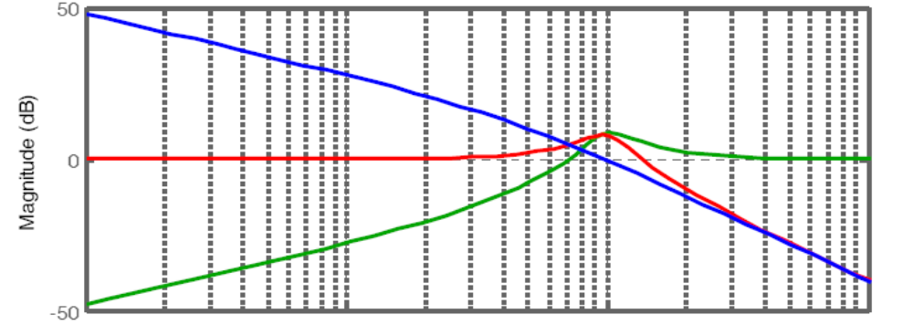







Closed loop transfer functions
+
-
Frequency (rad/s)
Notes:
{{{Gain Margin, Phase Margin}}}

Slide 4
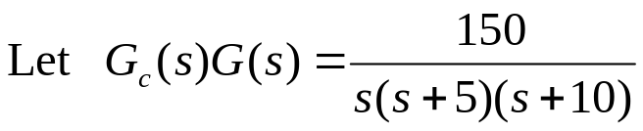
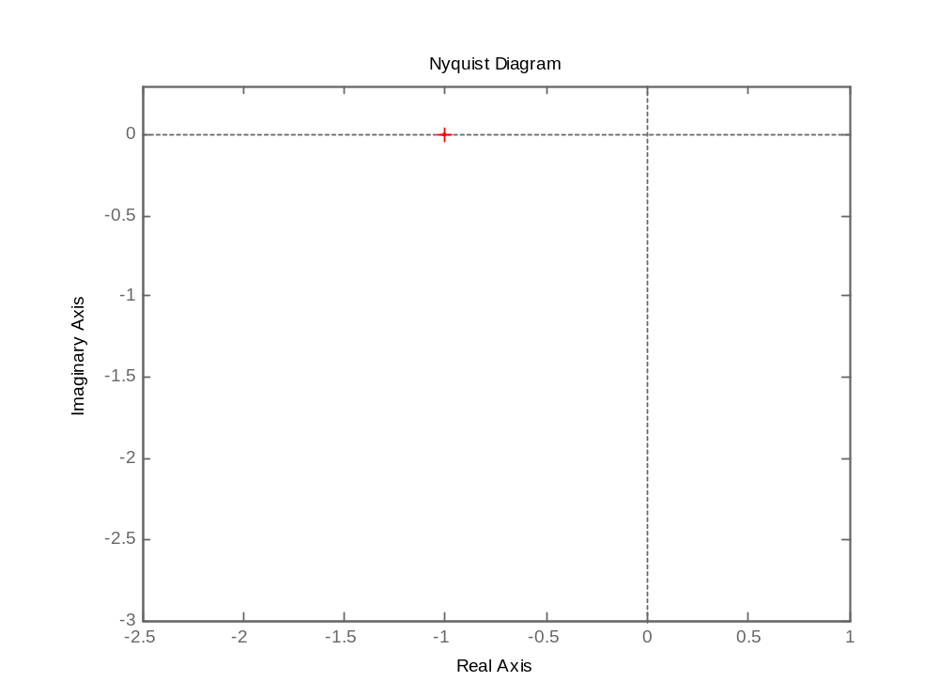
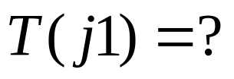









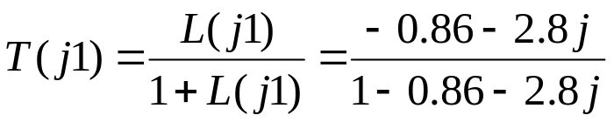






Closed loop values from Nyquist chart
+
-

Slide 5
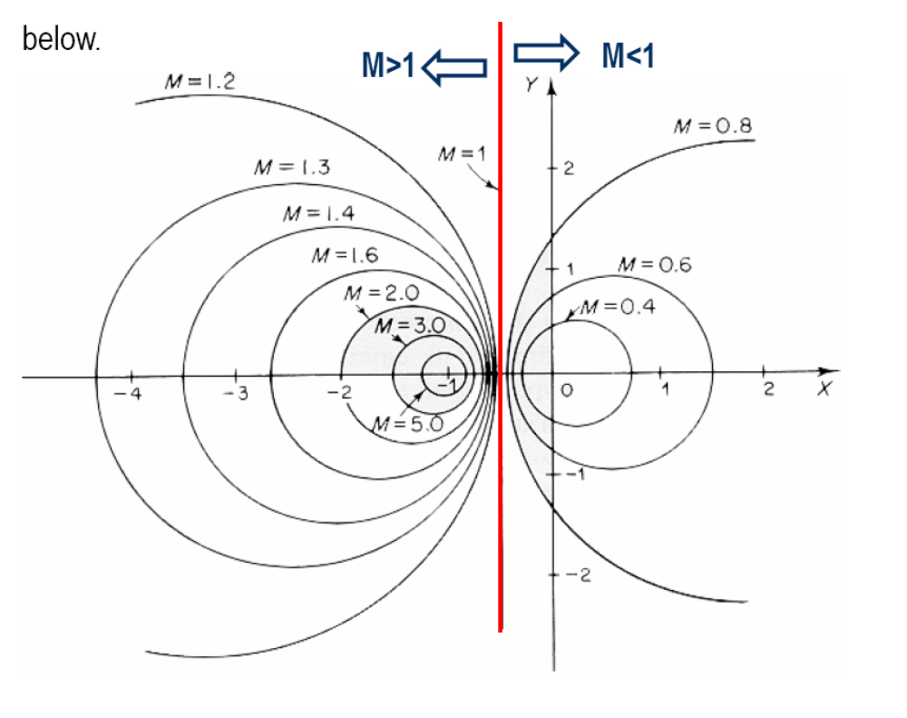
M circles (constant magnitude of T)

Slide 6
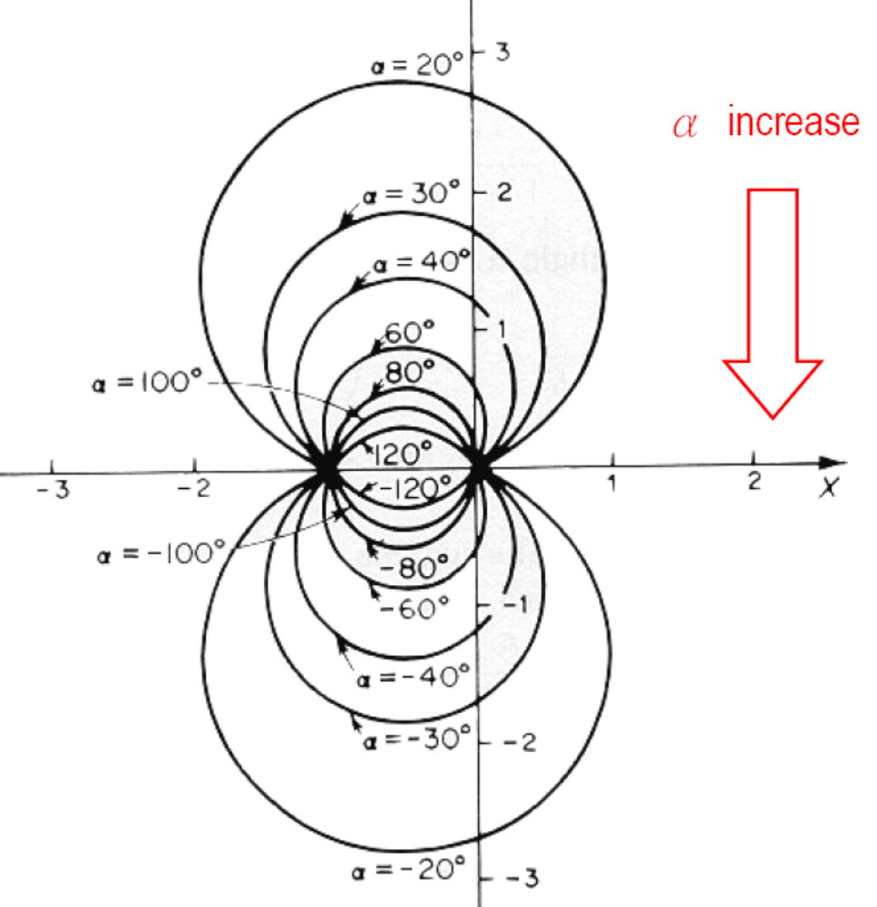
N circles (constant phase of T)

Slide 7
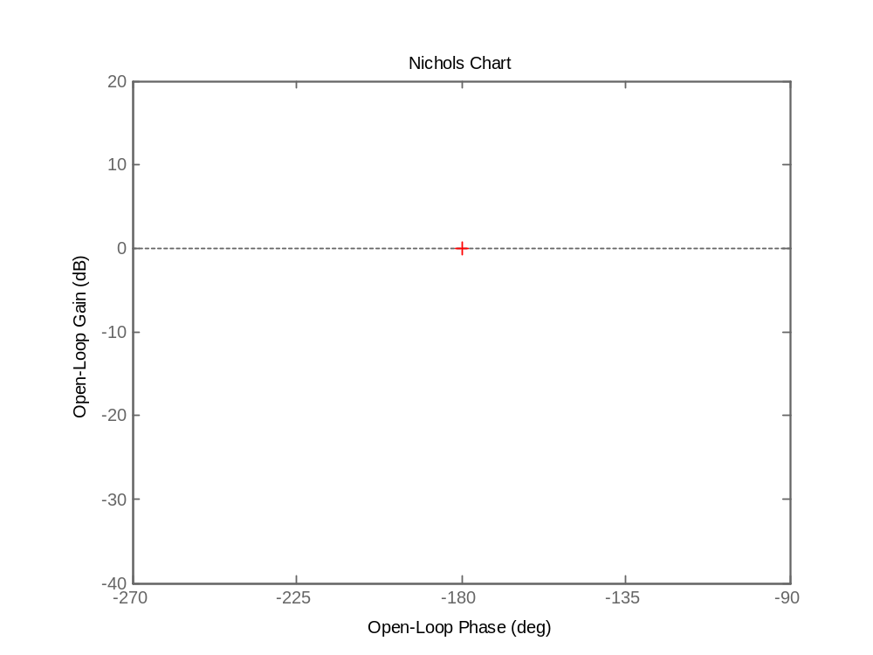
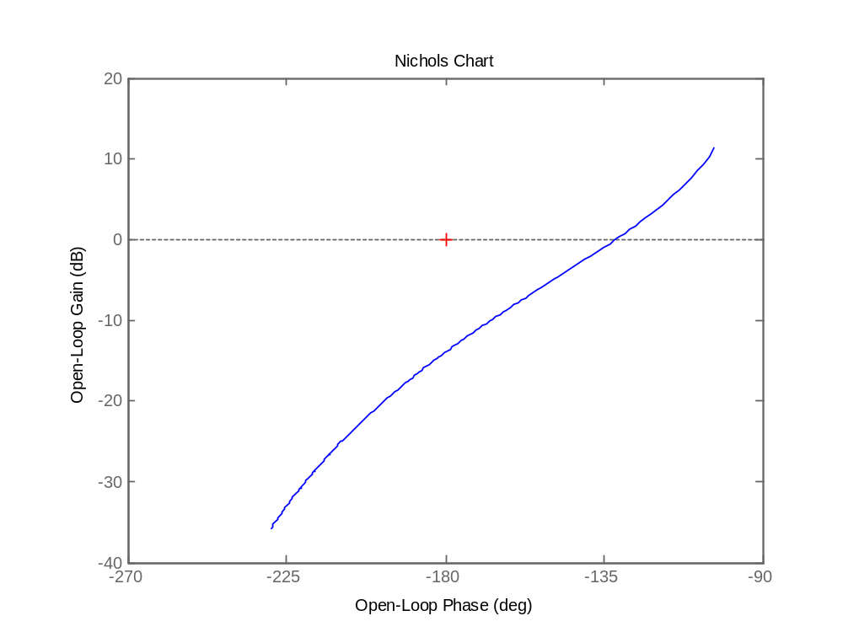





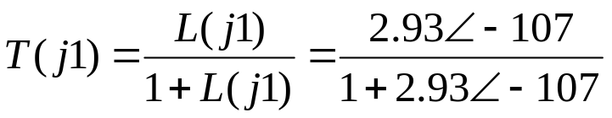

Closed loop values from Nichols chart
+
-

Slide 8
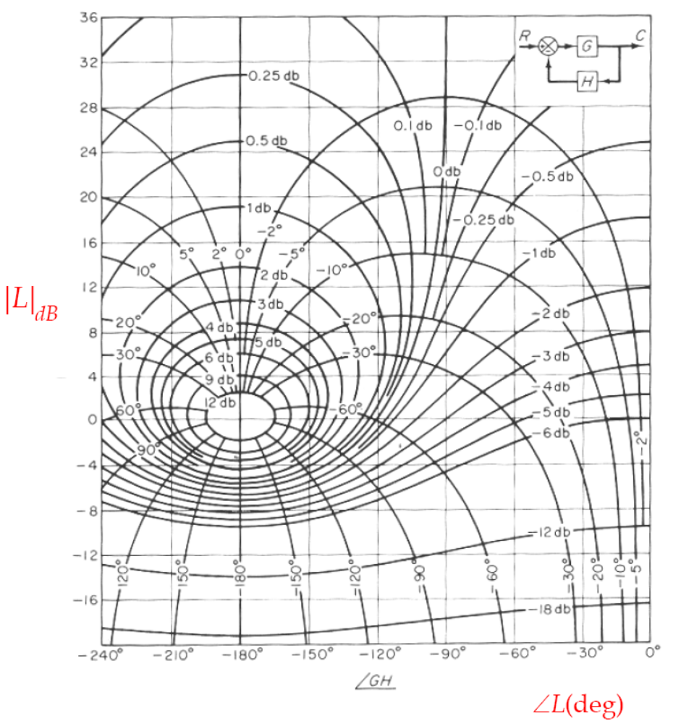


Constant gain and phase loci in Nichols chart
+
-
M circles and N circles
on Nichols chart

Slide 9
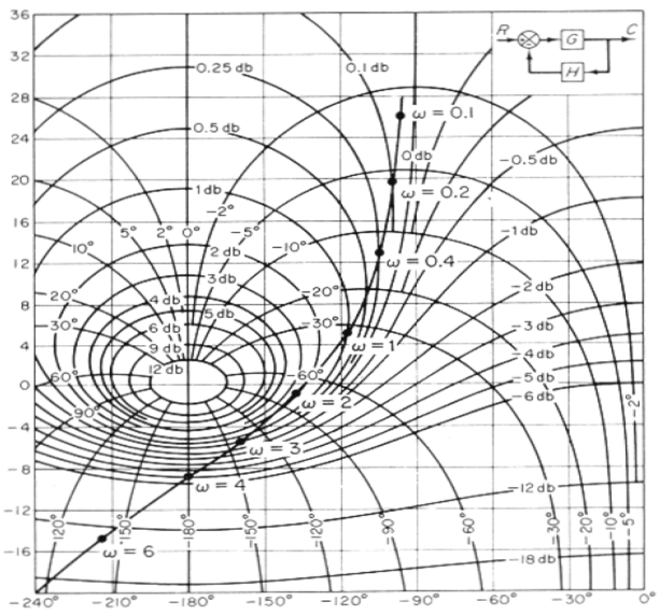
Nichols chart specification
+
How to plot |T| versus frequency?
-
How to plot <T versus frequency?
How to derive cross over frequencies?
How to derive φ_{m} and GM?
How to derive open loop bandwidth?
How to derive closed loop bandwidth?
How to derive M_{p}?
How to derive ω_{p}?
How to derive type of system?
How to derive error coefficient?

Slide 10
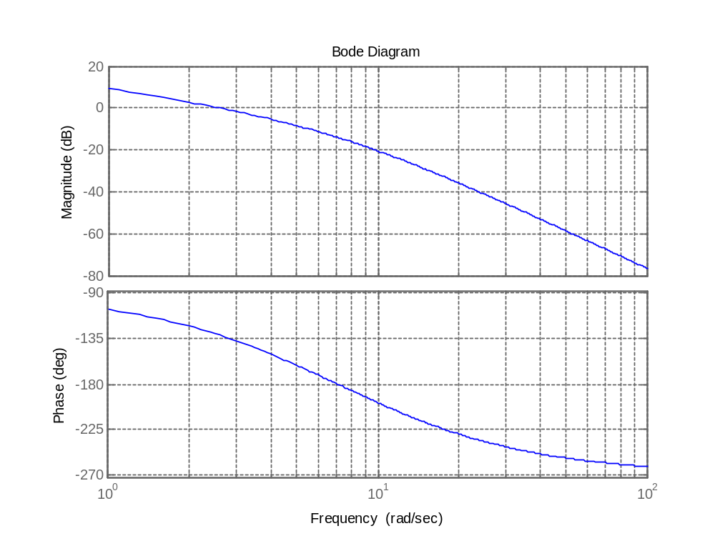

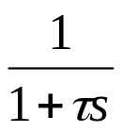

Effect of adding poles on Bode plot.
r
e
c₂
-
Adding poles
r
e
c₂
-
System speed
t_{r}
BW

Slide 11
Effect of adding poles on Nyquist plot.
r
e
c₂
-
Adding poles
-1
r
e
c₂
-
G(jw)

Slide 12
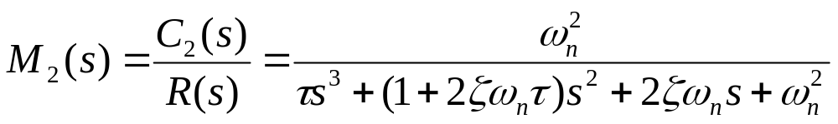

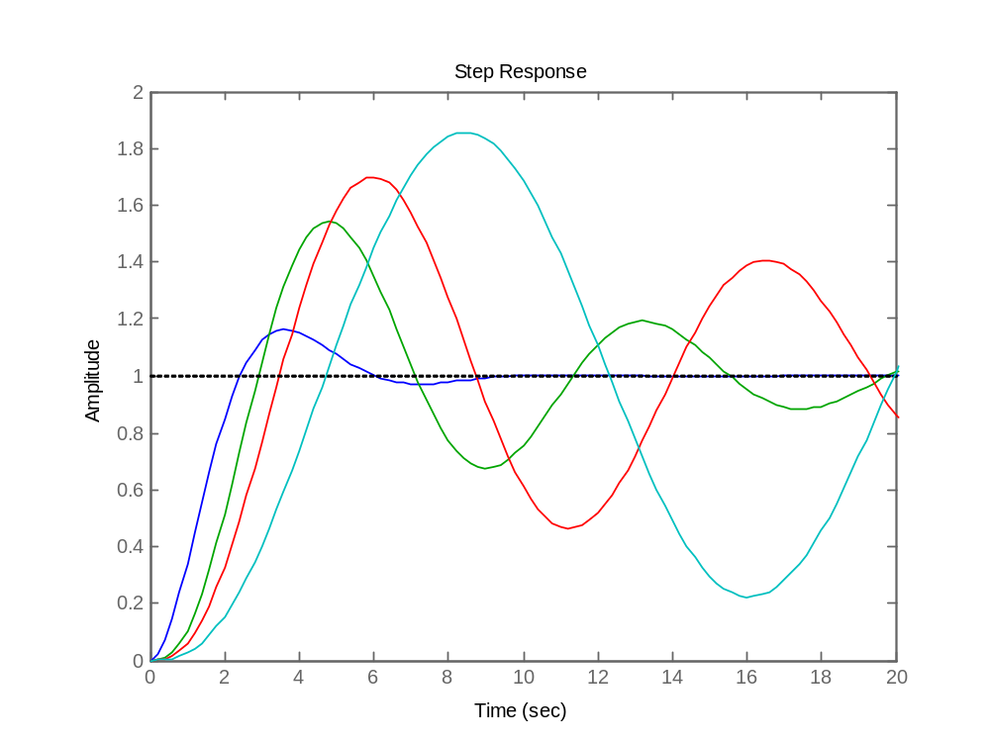
Adding poles to open loop transfer functions
اضافه کردن قطب به تابع انتقال حلقه باز
r
e
c₂
-
P.O.
τ=5.0
τ=2.0
t_{r}
τ=1.0
τ=0
System speed
BW
More problem as
poles go to ??

Slide 13

Effect of adding zeros on Bode plot.
r
e
c₂
-
Adding zeros
r
e
c₂
-
System speed
t_{r}
BW

Slide 14
Effect of adding zeros on Nyquist plot.
r
e
c₂
-
Adding zeros
-1
r
e
c₂
-
G(jw)

Slide 15
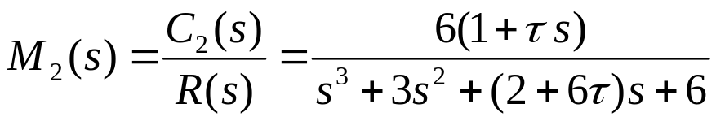

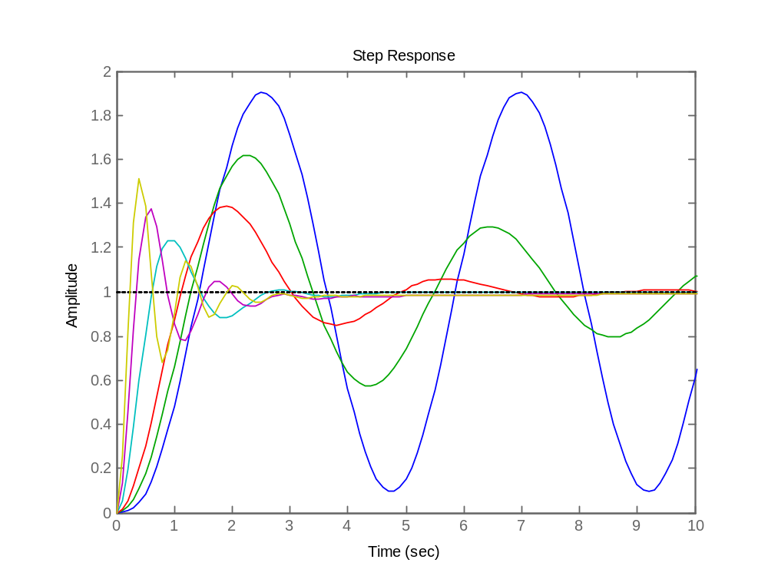
Adding zeros to open loop transfer functions
اضافه کردن صفر به تابع انتقال حلقه باز
r
e
c₂
-
P.O.
τ=0
τ=0.2
t_{r}
τ=10
τ=5.0
τ=0.5
τ=2.0
System speed
BW
Note: For τ<0 system
is unstable. Why?

Slide 16
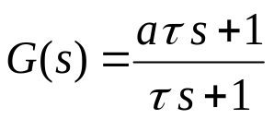

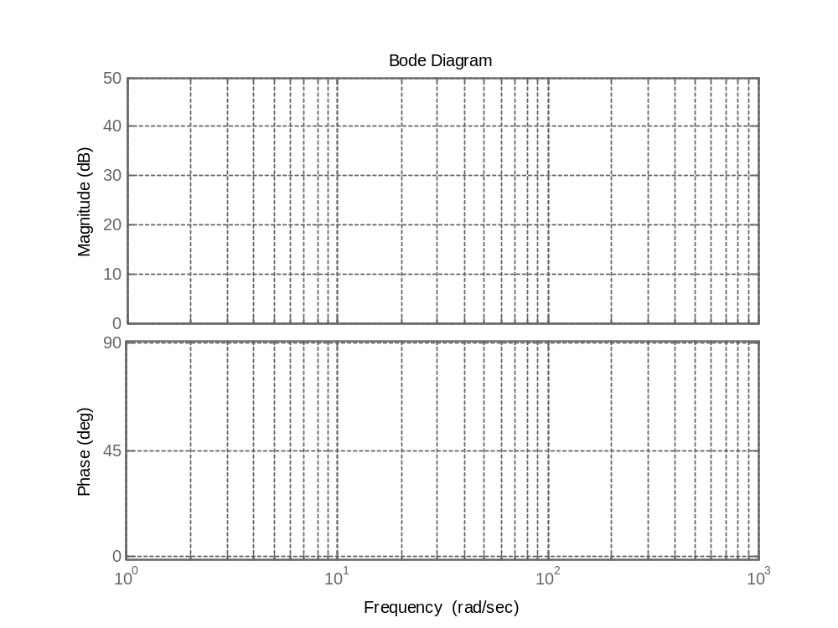




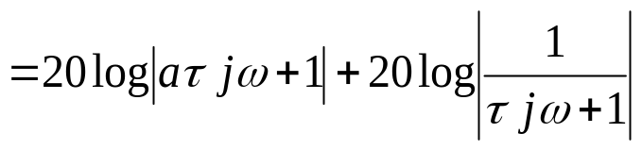





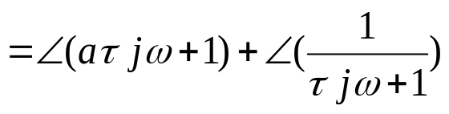



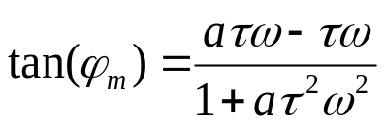



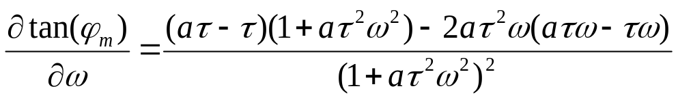
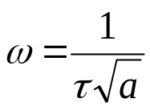
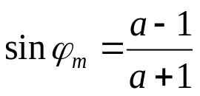

Example 1: Derive the Bode plot of following system.
Phase (deg) Magnitude (db)

Slide 17


Example 1: Derive the Bode plot of the following system.
Phase (deg) Magnitude (db)

Slide 18
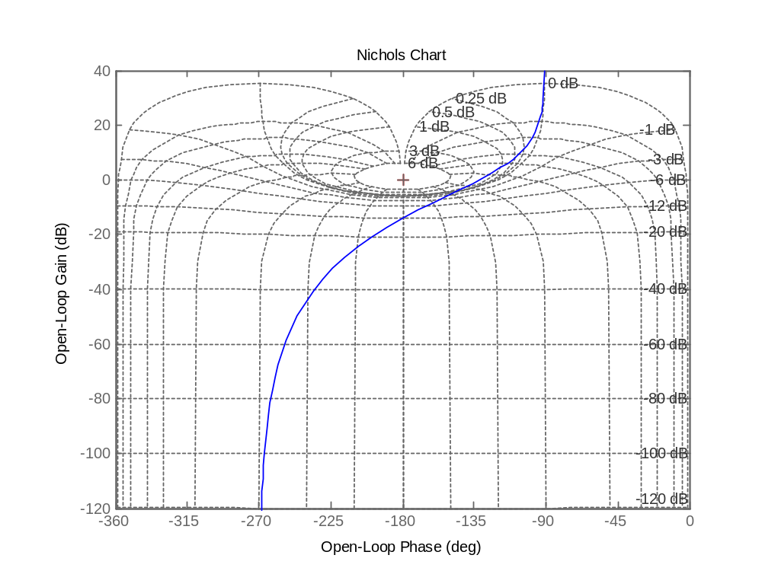
Exercises
تمرینها
1 The Nichols chart of an open loop system with negative unit feedback is shown.
a) Find the GM and PM.
b) Find M_{P}.
Notes:
<<<3.6>>>
###State Space Models###

Slide 19
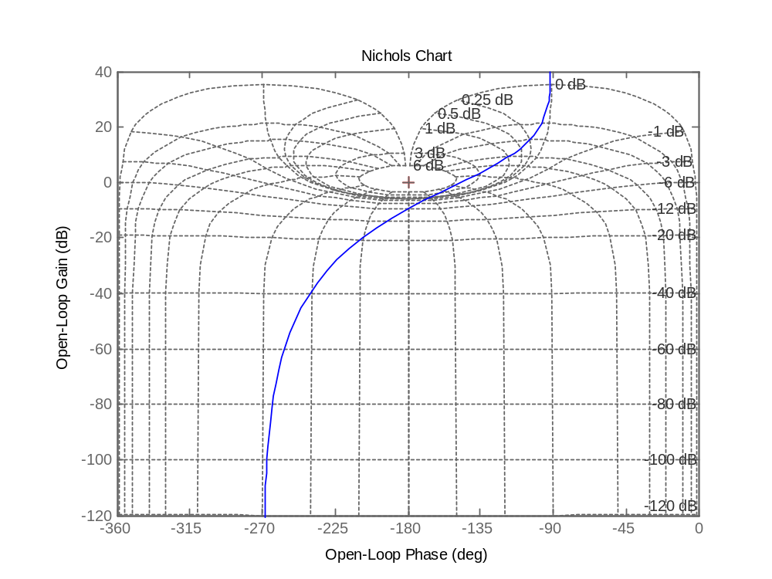






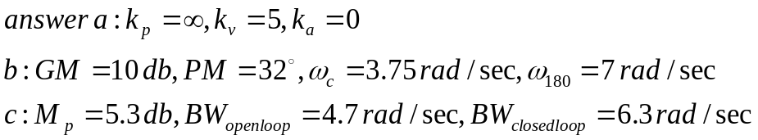
Exercises
تمرینها
2 The Nichols chart of a open loop system with negative unit feedback is shown.
a) Find the error constants
b) Find the GM and PM and gain crossover frequency and phase crossover frequency.
c) Find M_{P} , open loop bandwidth and closed loop bandwidth.
Notes:
<<<3.6>>>
###State Space Models###

